Slide 1
CMPE 220
Class – Operating Systems - part 2
Notes:
Let’s talk about history.
California State Railroad Museum – 1976 - docents worked on original steam engines.

Slide 2
What Does a Modern Operating System Do?
Process Management
Interprocess Communications
Input / Output (I/O) Management
Memory Management
File System Management
System Functions and Kernel Mode
User Interaction – (maybe)

Slide 3
(4) File System Management
The operating system is responsible for creating, deleting, opening, closing, reading and writing files on disk
It manages a “directory” to allow files to be accessed and located by name
It manages the organization and placement of file data on the disk
The File System uses the underlying I/O System to perform the physical I/O to and from the disk.

Slide 4
The File Catalog
Disk files are managed by the operating system. The system manages a catalog or directory of files, as well as file layout information.
The catalog is simple an index that maps files by name to their location on disk.
On most modern systems, the catalog is hierarchical, allowing for nested directories or folders.

Slide 5
File Layout on Disk
Files are made up of fixed size blocks. A file is a series of blocks; these blocks are mapped to corresponding physical blocks on the disk.
Logical Blocks in a FIle
Physical Blocks on Disk
Block 1
Block 1
Block 2
(some other file)
Block 3
Block 2
Block 4
Block 5
Block 5
Block 4
Block 3

Slide 6
File Layout on Disk
When disk media develops errors, some blocks may be marked as “bad” and not used.
Logical Blocks in a FIle
Physical Blocks on Disk
Block 1
Block 1
Block 2
(some other file)
Block 3
Block 2
Block 4
Bad Block
Block 5
Block 4
Block 3

Slide 7
Disk Fragmentation
Just like physical memory allocation, the space on disk becomes broken up into small chunks as files are added, deleted, expanded.
The result dramatically degrades system performance, because reading sequential data from disk becomes very slow.
Disk transfer rates are pretty fast
Disk rotation is slower… waiting for the disk to rotate to read the next block is expensive
Moving the disk head from track to track is slower still… so if the file blocks are scattered, reading successive blocks of data can be very expensive

Slide 8
Disk Fragmentation

Slide 9
Defragmentation
To reduce the performance impact of disk fragmentation, utility programs were developed to “defrag” the disk. This involved rewriting each file as a contiguous series of blocks, and eliminating unused space between files.
Defragmenting a large disk could take several hours, and the disk could not be used while the utility was running.
Modern operating systems dynamically defragment the disk, so it is in most cases no longer necessary to run a separate utility.

Slide 10
Defragmentation

Slide 11
(5) System Functions and Kernel Mode
Modern CPUs support two modes of instruction execution: user mode and kernel mode
When a process is running in user mode, its capabilities are restricted:
It cannot execute certain instructions, such as I/O instructions
It cannot trigger an interrupt
It cannot access a different process’s memory partition
The operating system needs to do all of those things, so system processes may run in kernel mode

Slide 12
Calling System Functions
User programs may call system functions that have been statically or dynamically linked. But since the entire process is running in user mode, those system functions still cannot perform restricted operations, such as initiating I/O, or even updating system control structures.
System functions have a mechanism for invoking code in kernel mode.
This mode switch is initiated with a special software interrupt, sometimes called a trap.

Slide 13
Switching Execution Modes
User Mode Process
System Function
Kernel Code
TRAP to enter kernel mode
Return to caller
Validate request
System Function ()
Switch to User Mode

Slide 14
Kernel Mode is Dangerous
Modern operating systems are well-protected. It’s very difficult for a program running in user mode to crash or penetrate the OS
Kernel mode allows essentially free reign to system structures and hardware
Code that is executed in kernel mode must be very well written and tested
Kernel code that is invoked via a trap must carefully validate the request

Slide 15
Traps Are Expensive
On most systems, switching into and out of kernel mode is a relatively expensive operation
Calls to kernel mode code should be kept to a minimum
A great deal of system optimization work goes into dividing the operations that can be performed in user mode from the operations that must be performed in kernel mode

Slide 16
Resource Conflicts
System processes – or system calls from user processes – may often access the same resource (for example, multiple processes may be updating PCBs or IOCBs)
This introduces the possibility of errors
Process 1 is in the midst of making some updates to PCBs
In the midst of the changes, process 2 gets control – but the changes process 2 tries to make may conflict with the changes process 1 is making. Or, process 2 may run into errors accessing the PCBs, because they are in an inconsistent state.
There are two ways to resolve this problem

Slide 17
Uninterruptible Code Segments
Some systems allow small sections of code to be protected from interrupts
Process 1 can safely update the PCBs, knowing that it cannot lose control until the changes are complete
Risk: too many sections of uninterruptible code can effectively “lock out” other processes

Slide 18
Resource Locks
Critical resources can be locked so that other processes cannot access the resource until the current process unlocks it
To accomplish this, each critical shared resource is associated with a semaphore or mutex (mutual exclusion flag). Testing and setting is an atomic operation that cannot be interrupted.
Once a process has the semaphore, it can safely use the resource until it releases the semaphore

Slide 19
Resource Locking Can Lead to “Deadlocks”
Assume two processes, 1 and 2, each require the use of resources A and B – but request them in the opposite order!
Process 1 requests the resource A semaphore – and gets it.
At that point, Process 1 loses control. Process 2 then gets control, and requests the resource B semaphore – which it gets.
This leads to a deadlock – neither Process 1 nor Process 2 can continue.
Process 1
Has the Resource A semaphore
Is waiting for the Resource B semaphore
Process 2
Has the Resource B semaphore
Is waiting for the Resource A semaphore

Slide 20
Deadlock Detection and Prevention
Very hard to debug
Because there may be only tiny “windows” that can result in a deadlock, they may occur rarely, and be very hard to locate and debug
Deadlock detection and prevention is a major research area in computer science
Current detection algorithms tend to be very resource intensive and have a large impact on system performance

Slide 21
(6) User Interaction (maybe)
The early “proto operating systems” – Job Control Programs – accepted a limited set of commands directly from the input device (typically a card reader)
By the late 1950s, most computers had a console where commands could be entered and messages could be output
Today, user interactions are not part of the operating system
A shell accepts user command, and runs programs or calls system functions to execute them
A windowing system interacts with the user through a Graphic User Interface (GUI) and runs programs or calls system functions as required

Slide 22
What Does a Modern Operating System Do?
Process Management
Interprocess Communications
Input / Output (I/O) Management
Memory Management
File System Management
System Functions and Kernel Mode
User Interaction – (maybe)

Slide 23
Types of Operating Systems

Slide 24
Embedded Systems (Generalizations)
May not support a hardware MMU
Single address space
Limited physical memory
Might not support a disk or mass storage device
Code is loaded from non-volatile memory
Swapping is not possible – limited to physical memory
May still support a simple multi-process software architecture
Little or no ability for user to add/modify software
Fewer security issues

Slide 25
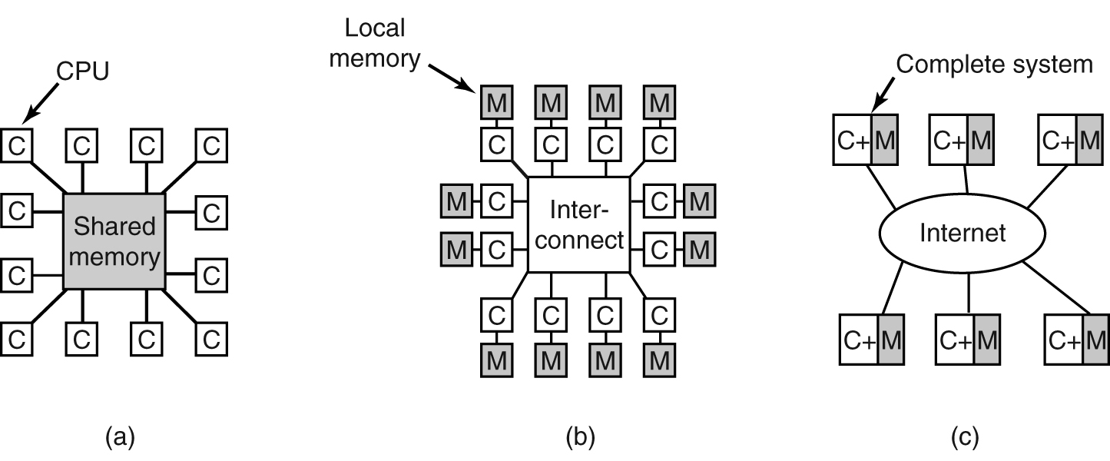
Multiprocessor Architectures
The goal of Multiprocessor Architectures is to provide greater system throughput through parallelism
Network
Tightly Coupled (Shared Memory)
Loosely Coupled (Message Passing)
Networked (Distributed)
Multicore Architecture

Slide 26
Multiprocessor Operating Systems
The core functions of the OS remain unchanged:
Process management
Scheduler, dispatcher
Memory Management
I/O Management
File Management
The resources that they manage are expanded. For example, the scheduler can assign processors to multiple CPUs.

Slide 27
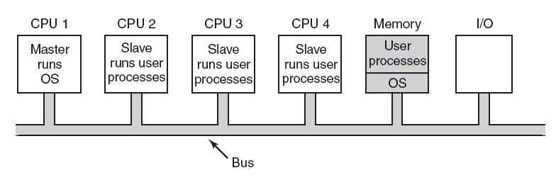
Multiprocessor OS: Master-Slave
One copy of the OS runs on the Master CPU
Slave processors make all OS calls to the Master CPU

Slide 28
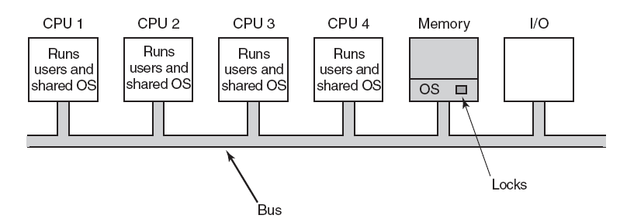
Multiprocessor OS: Symmetric
OS Processes can run on any CPU
Requires memory “lock” on shared OS data structures

Slide 29
Breaking Out of the Box
Operating Systems Across “Computer” Boundaries

Slide 30
Network vs Distributed Operating Systems
Both provide a means of sharing resources across a communications network
Network Operating System: access to remote resources is explicit
Distributed Operating System: access to remote resources is implicit – programs may not know about locality of references
Cloud Operating system: manages the operation, execution and processes of virtual machines, virtual servers and virtual infrastructure, as well as the back-end hardware and software resources.

Slide 31
Network Operating Systems
Almost all modern operating systems are ”networked”
POSIX, Mac OS, Windows, IOS, Android: YES
Embedded systems: MAYBE
Remote resources are accessed via explicit communication protocols
FTP, SFTP, RPC, telnet, SSH
Client-Server applications are supported through standard communication protocols (i.e. TCP/IP)
The basic architecture of the Internet
We’ll talk more about this architecture in the next class when we discuss “server” software

Slide 32
Distributed Operating Systems
Users are not aware that they are on a network
Access to remote resources is similar to access to local resources
Transparent access to remote files

Slide 33
Distributed OS: Access to Remote Files
Remote File Access: Each file access traverses the network
File Migration / Data Migration: File is copied to local machine, accessed, then copied back (requires a file locking mechanism)
Program Migration: Program is executed on remote machine, where is has direct access to the file

Slide 34
Distributed OS: Process Migration
Execute an entire process, or parts of it, on a remote system
Allows:
Load balancing
Access to special purpose hardware or software

Slide 35
Cloud Operating System
A cloud OS virtualizes system resoruces.
A cloud OS is a distributed OS that allows multiple operating systems to coexist on a single “system,” or a single OS to span multiple “systems.”
A web OS is a specialized type of cloud OS. All resources are available through a web browser
Similar to a concept pioneered at Sun Microsystems ca. 2005
“The network is the computer” – Scott McNealy

Slide 36
Object Oriented Operating Systems
Extend the object oriented programming paradigm into the OS… the operating system manages resources as objects
An active research area from the mid-1980s through the mid-1990s
There are no mainstream examples today

Slide 37
For Next Week
Log in to Canvas and complete Assignment 6

